Slide 1
Dominos - Predictive Purchase Order System
Capstone Project – 5
By
Arangarajan Vinayagam

Slide 2
Problem Statement
Dominos is seeking to optimize its ingredient ordering process by accurately predicting future sales and generating efficient purchase orders.
The company faces challenges related to inventory management, such as minimizing ingredient waste due to overstocking and avoiding stockouts that disrupt operations.
These inefficiencies not only lead to increased costs but also negatively impact customer satisfaction and overall operational efficiency.

Slide 3
Objectives
Accurate Sales Prediction: Develop a accurate predictive model to forecast future sales based on historical sales data and trends.
Efficient Ingredient Ordering: Prepare a purchase order system that aligns with predicted sales of Pizzas to ensure an optimal inventory level.
Waste Reduction: Minimize ingredient wastage by avoiding overstocking and managing inventory efficiently.
4. Cost Optimization: Reduce costs associated with excess inventory, storage, and expired ingredients.

Slide 4
Project Overview
Project Overview: Based on the pattern in Pizza sales, predicted the future sales using advanced Machine learning techniques. Based on the forecasted Pizza sales, ingredients-oriented purchase order is created.
The complete strategy of analysis as follows:
Data Processing:
Step 1: Load Pizza sales and ingredients csv files and read with pandas
Step 2: Handling missing values (Pizza sales dataset)
Check null values in the Pizza sales data set: df_pizza.isnull().sum()
pizza_id 0
order_id 0
pizza_name_id 16
quantity 0
order_date 0
order_time 0
unit_price 0
total_price 7
pizza_size 0
pizza_category 23
pizza_ingredients 13
pizza_name 7
Found null values in the following columns:
Pizza_name_id,
total_price,
pizza_category,
pizza_ingredients,
pizza_name

Slide 5
Data Processing
Step 4: Merged Pizza_Sales and Ingredients DataFrames
Fill null values in Pizza Categories Based on Pizza Name ID (Mapping Pizza Name ID to Fill missing values of Pizza Category)
Fill null values in Pizza Ingredients Based on Pizza Name (Mapping Pizza Name to Fill Pizza Ingredients)
Fil null values in Missing Pizza Name Based on Pizza Ingredients (Mapping Pizza Ingredients to Fill Pizza Name)
Fill null values in Missing Pizza Name ID Based on Pizza Name (Mapping Pizza Name to Fill Pizza Name ID)
Step 5: Handling missing values (Pizza ingredients)
Check null values in the Pizza ingredients data set: df_ingred.isnull().sum()
pizza_name_id 0
Pizza_name 0
Pizza_ingredients 0
Items_Qty_in_Grams 4
Fill null values in ‘items_Qty in Grams’, with mean value

Slide 6
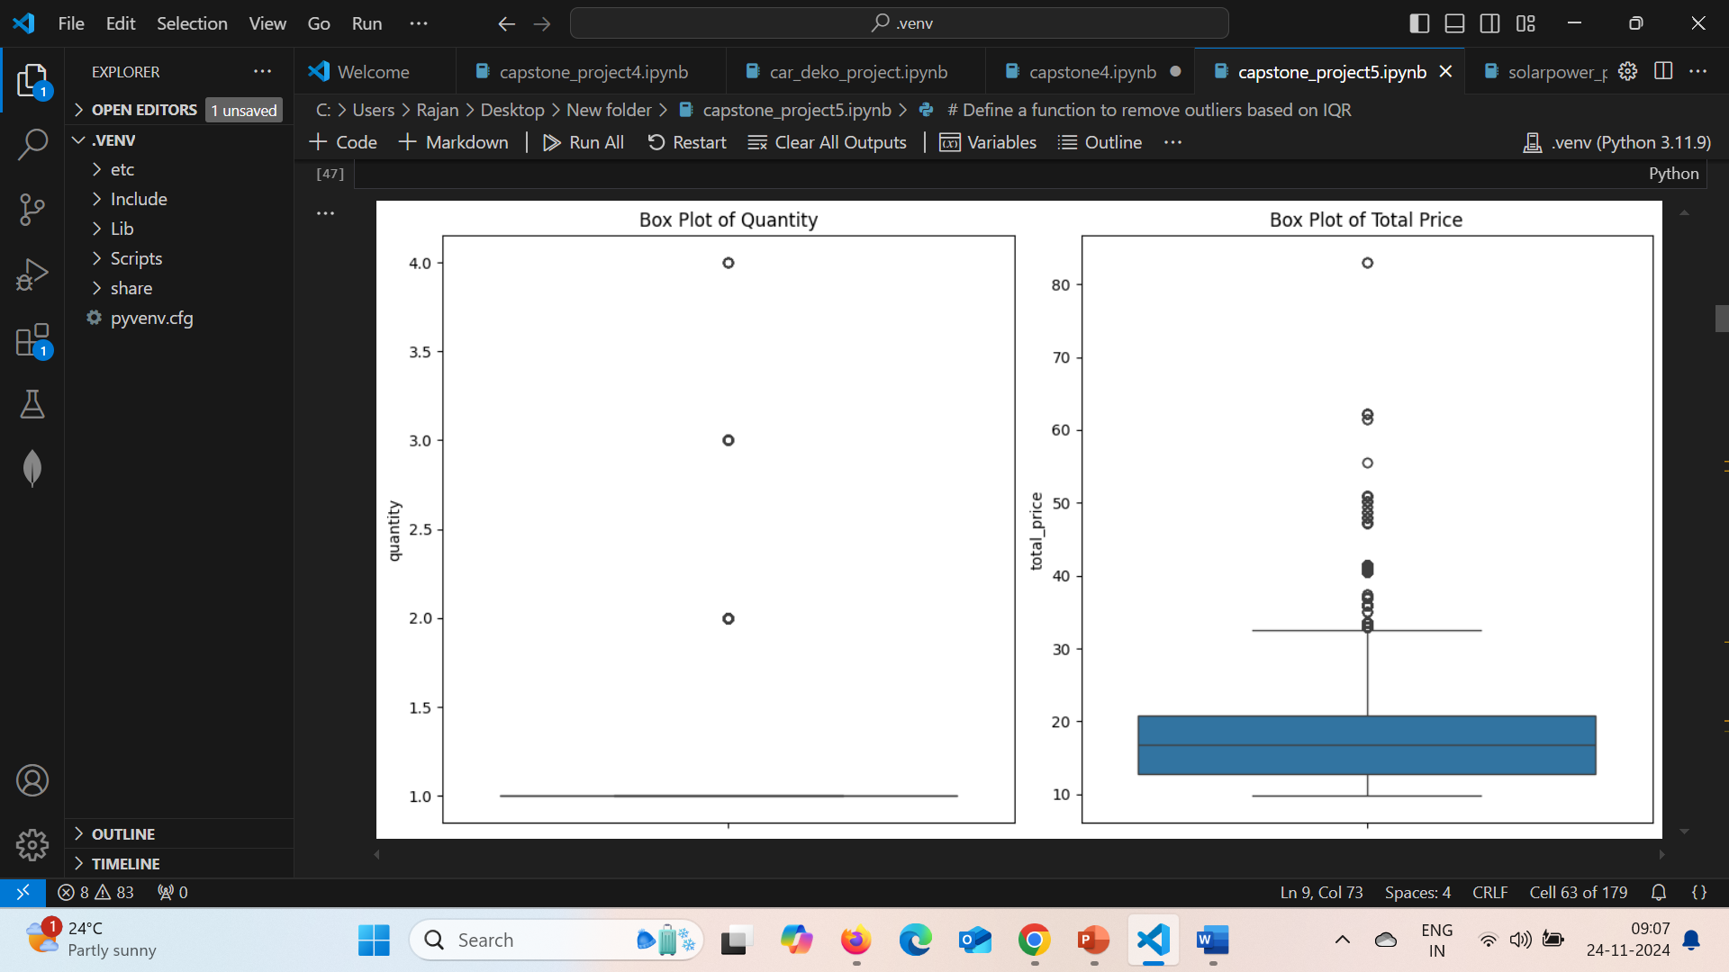
Data Processing
Step 6: Check and removed duplicates in merged dataset
Step 7: Convert ‘order date’ into date-time format
Step 8: Check outliers with ‘Quantity’ and ‘Total_price’ using IQR method
Identified outliers and removed
def remove_outliers_iqr(df, column):
Q1 = df[column].quantile(0.25)
Q3 = df[column].quantile(0.75)
IQR = Q3 - Q1
lower_bound = Q1 - 1.5 * IQR
upper_bound = Q3 + 1.5 * IQR
# Return the DataFrame without outliers
return df[(df[column] >= lower_bound) & (df[column] <= upper_bound)]

Slide 7
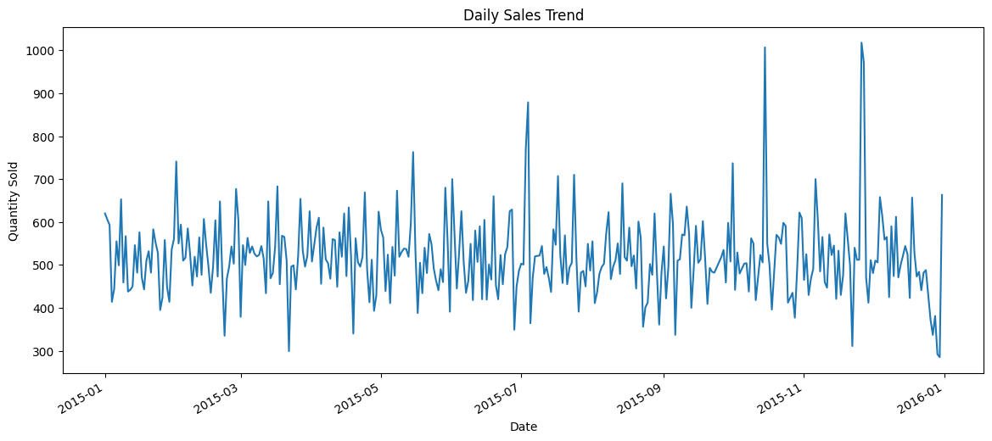
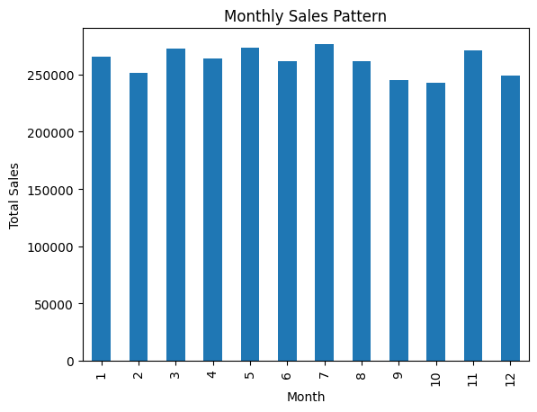
Data Exploration
Step 9: Exploratory Data Analysis
Plotting sales quantity over time
(to know the sales pattern over the time)
Plotting sales over the months
(to know the monthly sales pattern)

Slide 8
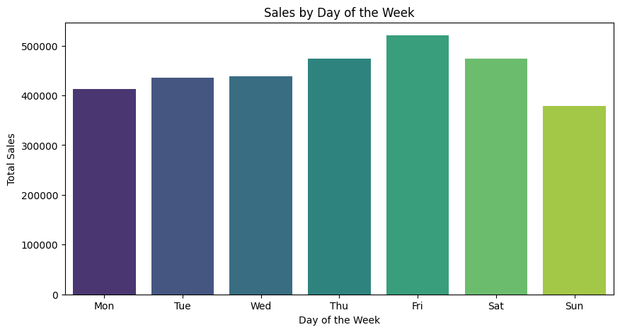
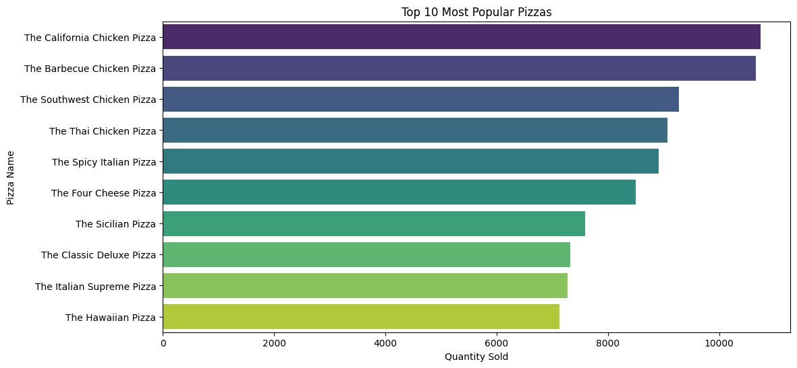
Data Exploration
Step 9: Exploratory Data Analysis
Plotting sales over day of the week
(to know the sales pattern over the day)
Plotting sales of pizza_names with quantity
(to know the highest sales of pizza type)

Slide 9
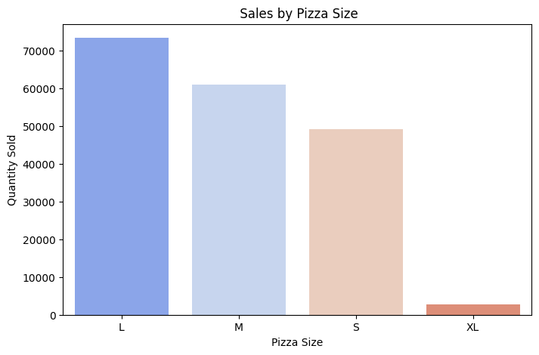
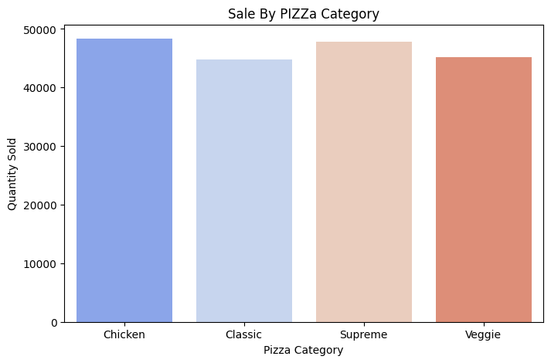
Data Exploration
Step 9: Exploratory Data Analysis
Plotting sales by pizza size
(to know the sales pattern by size of pizza types)
Plotting sales by pizza category
(to know the sale pattern by category)

Slide 10
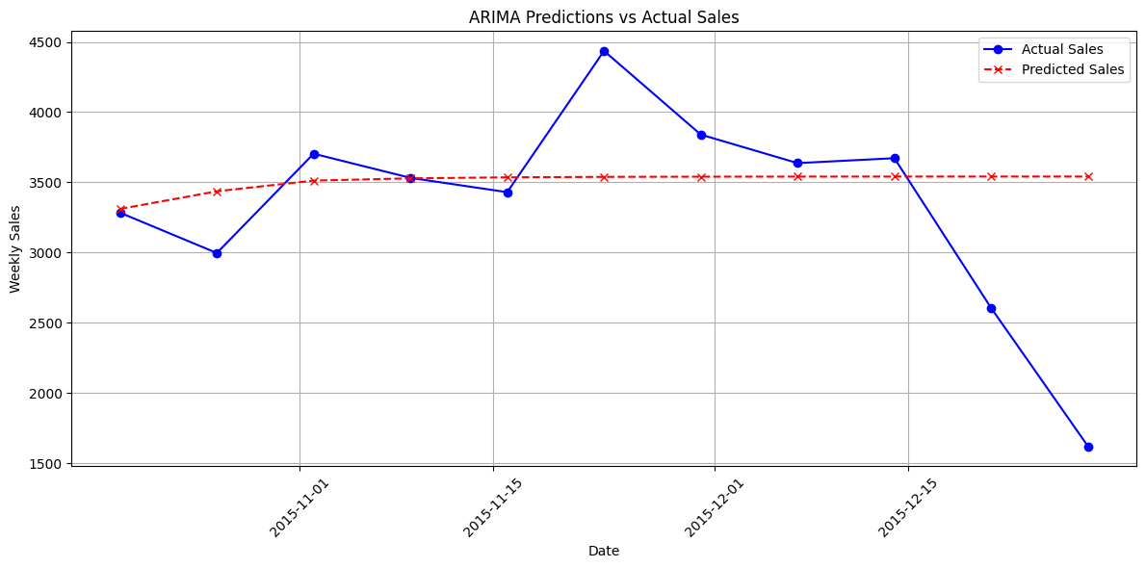
Sales Prediction
Step 1: Feature Engineering
Create new columns to add (year, week, day of week, month, holidays, promotion (week end)) with dataset
Step 2: Prepared the dataset with weekly wise and segregated data for train and test
Step 3: Selected the Model Arima
Install the relevant libraries
Tune the ARIMA model with key parameters (p_values, d_values, q_values = range(0, 5), range(0, 2), range(0, 5))
Identified the best model fit with evaluation of MAPE
(Best ARIMA Model MAPE: 0.1932, Best Parameters: (1, 0, 3))
Predictions:
order_date
2015-10-19 3310.914027
2015-10-26 3436.377035
2015-11-02 3512.464718
2015-11-09 3528.520319
2015-11-16 3535.737056
2015-11-23 3538.980864
2015-11-30 3540.438905
2015-12-07 3541.094271
2015-12-14 3541.388847
2015-12-21 3541.521255
2015-12-28 3541.580770

Slide 11
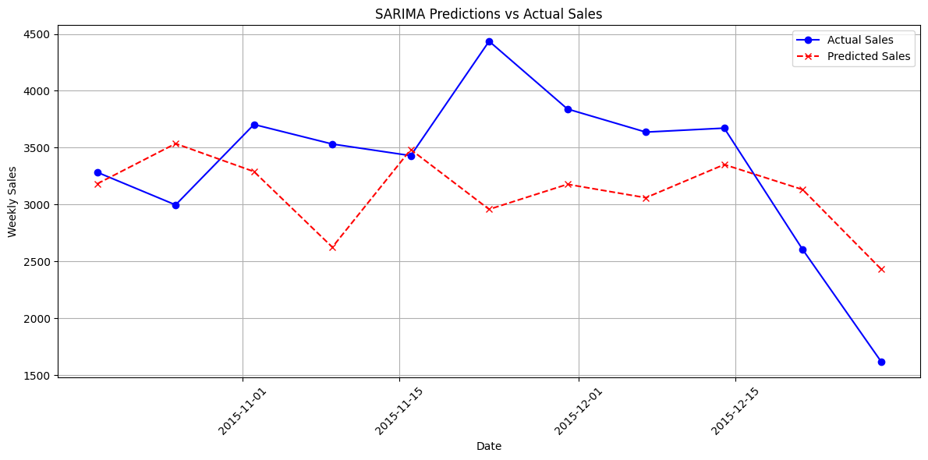
Sales Prediction
Step 4: Selected the Model Sarima
Train the SARIMA model with assigned key parameters order=(1, 1, 1), seasonal_order=(1, 1, 1, 7)
Best SARIMA Model MAPE: 0.1864
Predictions:
order_date
2015-10-19 3182.227558
2015-10-26 3535.994183
2015-11-02 3289.825803
2015-11-09 2625.358300
2015-11-16 3483.629115
2015-11-23 2958.137234
2015-11-30 3178.137305
2015-12-07 3060.079772
2015-12-14 3351.726126
2015-12-21 3131.844498
2015-12-28 2433.569239

Slide 12
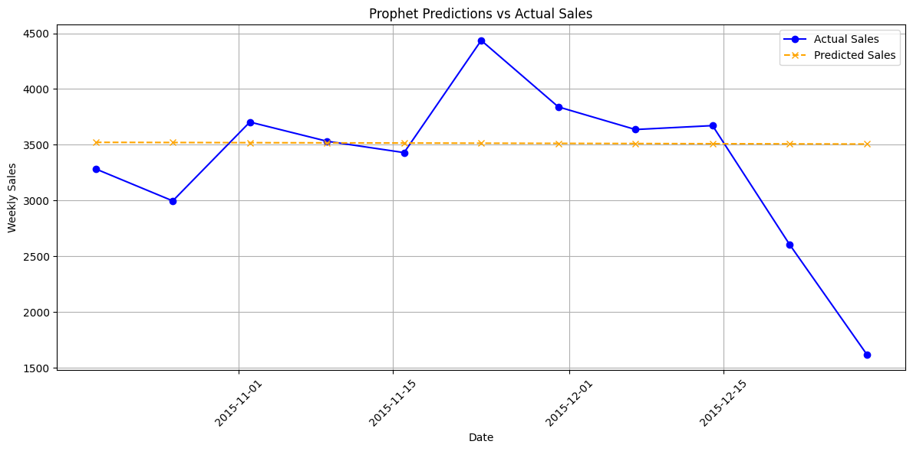
Sales Prediction
Step 5: Selected the Model Prophet
Assign variable name ‘ds’ (order date) as input feature and ‘y’ (quantity) as target to train model
Best Prophet Model MAPE: 0.2007
Predictions:
ds
2015-10-19 3522.082782
2015-10-26 3520.538119
2015-11-02 3518.993457
2015-11-09 3517.448794
2015-11-16 3515.904131
2015-11-23 3514.359469
2015-11-30 3512.814806
2015-12-07 3511.270143
2015-12-14 3509.725481
2015-12-21 3508.180818
2015-12-28 3506.636155

Slide 13
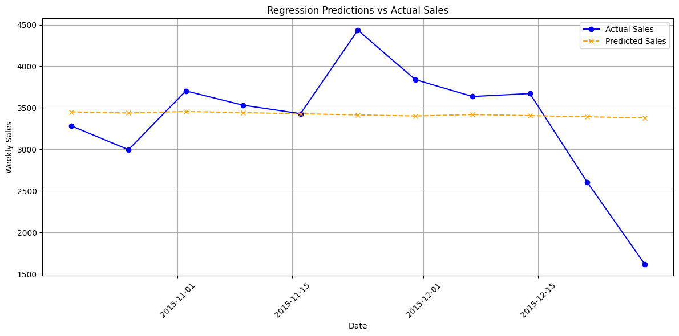
Sales Prediction
Step 6: Selected the Model Linear regression
Assign input features ('week_of_year', 'day_of_week', 'month', 'year’) and target (‘quanity’)
Train the Regression model
Best Regression Model MAPE: 0.1958
Predictions:
order_date
2015-10-19 3451.454193
2015-10-26 3438.002624
2015-11-02 3455.905575
2015-11-09 3442.454007
2015-11-16 3429.002439
2015-11-23 3415.550870
2015-11-30 3402.099302
2015-12-07 3420.002253
2015-12-14 3406.550684
2015-12-21 3393.099116
2015-12-28 3379.647548

Slide 14
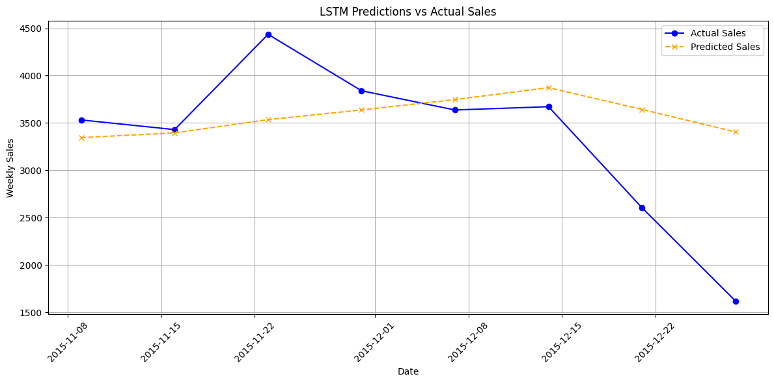
Sales Prediction
Step 6: Selected the Model LSTM
Train the LSTM model with following assigned parameters:
(epochs=50, batch_size=32, model = Sequential(), neurone=50,activation='relu,
model.compile(optimizer='adam', loss='mse')
Best LSTM Model MAPE: 0.2379
Predictions:
order_date
2015-11-09 3345.226318
2015-11-16 3395.412598
2015-11-23 3534.989746
2015-11-30 3637.863525
2015-12-07 3746.789062
2015-12-14 3873.464355
2015-12-21 3643.023926
2015-12-28 3405.651367

Slide 15
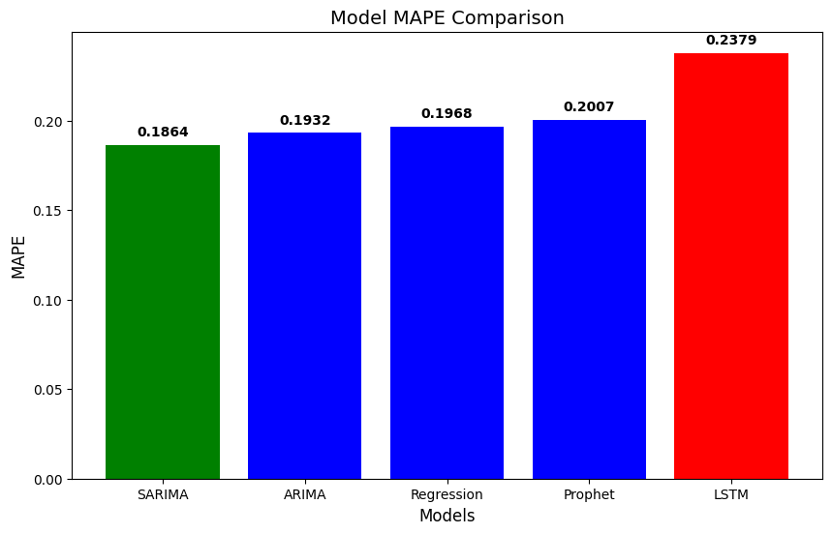
Sales Prediction
Step 7: Identified the best model is SARIMA with following comparison of MAPE results:
Step 8: Applying SARIMA Model for Forecasting (one week)
Step 9: With each Pizza name, (with features of Order date and quantity), sum of quantities for each pizza name is predicted
Step 10: According to ingredients of each pizza type, the required quantity of ingredients are estimated for one week period

Slide 16
Sales Prediction
Step 11: Based on the requirement of ingredients, purchase order for ingredients is created

Slide 17
Thank You

